Slide 1

Computer Vision based camera for capturing Gait pattern of human subjects
Under the guidance of:-
Dr.Srikanth Sugavanam
Presented by :
R. Ramakrishna Kashyap

Slide 2
Introduction
Gait analysis is an assessment of the way the body moves, usually by walking or running, from one place to another.
The purpose of gait analysis is to detect any abnormalities in locomotion.
Gait analysis is used to assess and treat individuals with conditions affecting their ability to walk.
Planned Deliverables
Python script that calculates the angle between the joints estimated from
live camera feed.
Unity simulation of the estimated pose.

Slide 3
Methodology
Capture live feed from camera
Estimate human pose & calculate Angle of joints
Render a 3D Model on Unity

Slide 4
Applications/Libraries used
Pose Mediapipe
MediaPipe offers customizable ML solutions for live and streaming media.
OpenCV
Library in python which is a computer vision library that is widely used for image analysis, image processing, detection, recognition, etc.
Unity hub
Unity is a cross-platform game engine used by many games on the Google Play Store. Unity's modular tools help you produce and deliver highly engaging 2D or 3D mobile games.

Slide 5

Pose Landmark Model
Image Source: Mediapipe

Slide 6
Algorithm
1. Import necessary libraries (cv2, mediapipe, numpy, csv)
2. Define function calculate_angle(a,b,c) to calculate angle between joints
input: a, b, c (coordinates of joints)
output: angle (in degrees)
3. Initialize MediaPipe pose object with minimum detection and tracking confidence level
4. Open camera with OpenCV
5. While camera is open:
a. Read frame from camera
b. Convert frame to RGB color format
c. Detect pose using Media Pipe pose object
d. Draw landmarks on frame
e. Extract coordinates of right arm joints (shoulder, elbow, wrist)
f. Calculate angle between right arm joints using calculate angle function
g. Display frame with detected landmarks
h. Check for 'q' key press to exit loop
6. Release camera and close windows

Slide 7
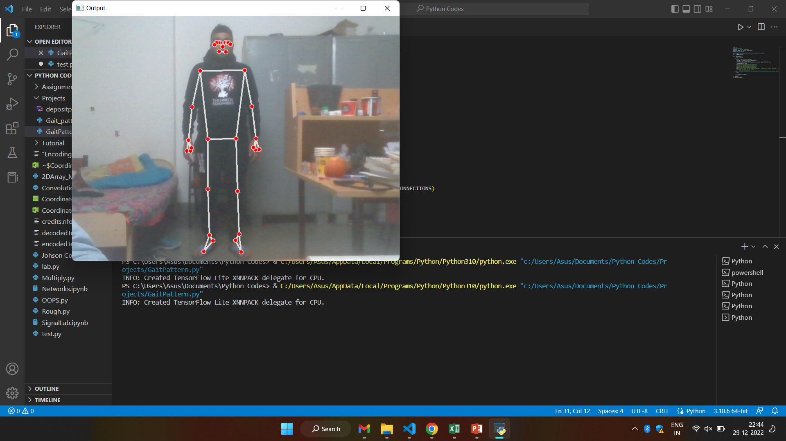
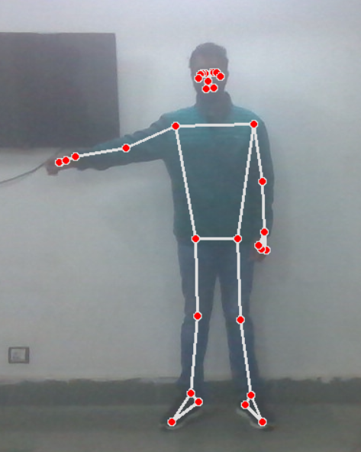
Work done
Pose estimates

Slide 8
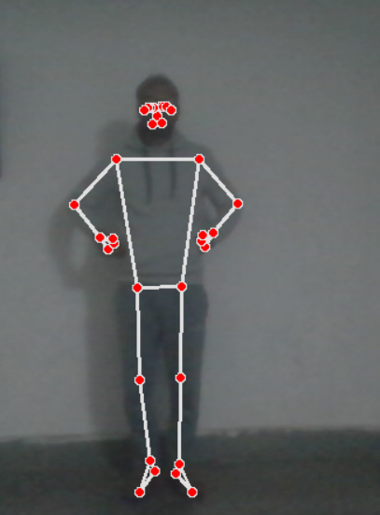
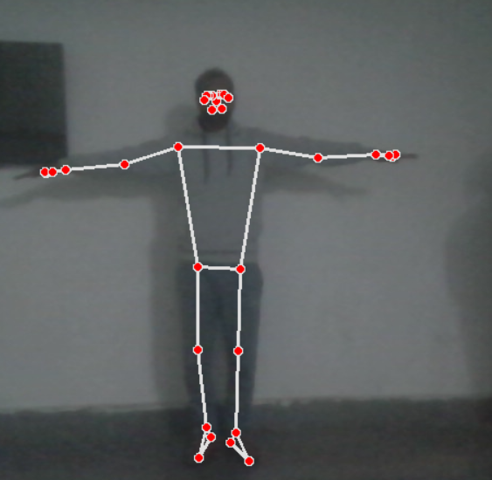
Pose estimation under low light conditions

Slide 9
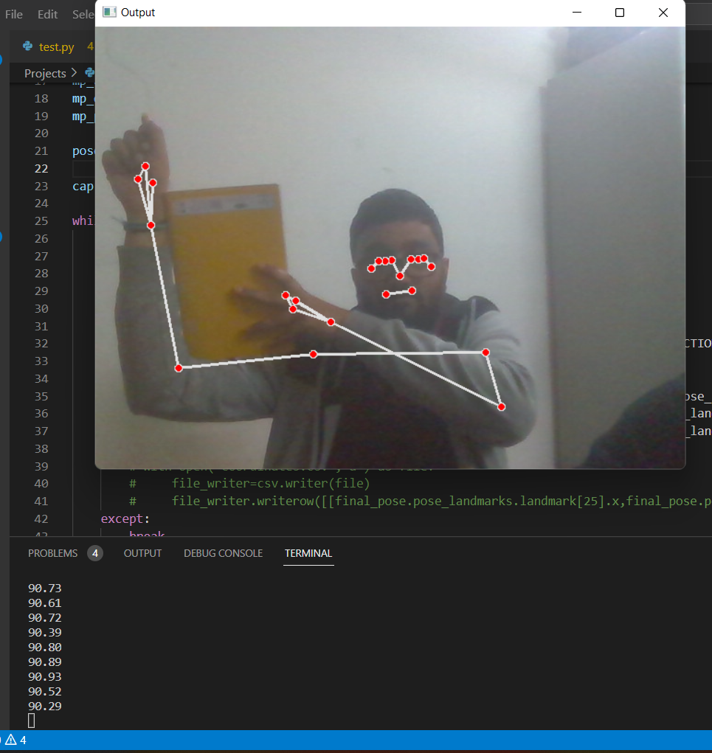
Validation of obtained results

Slide 10
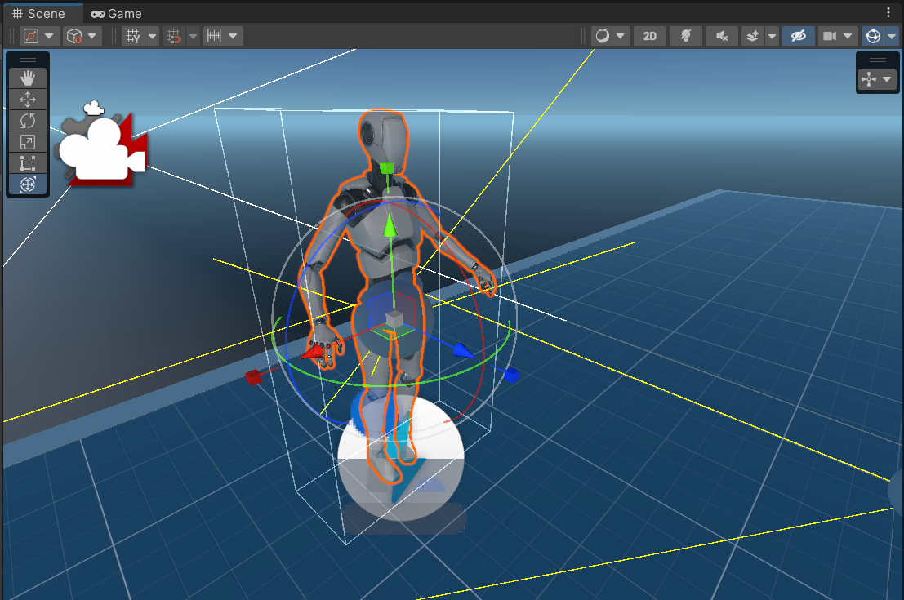
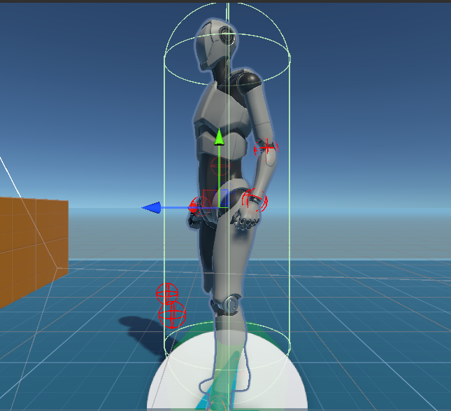
Unity Asset Initialization

Slide 11
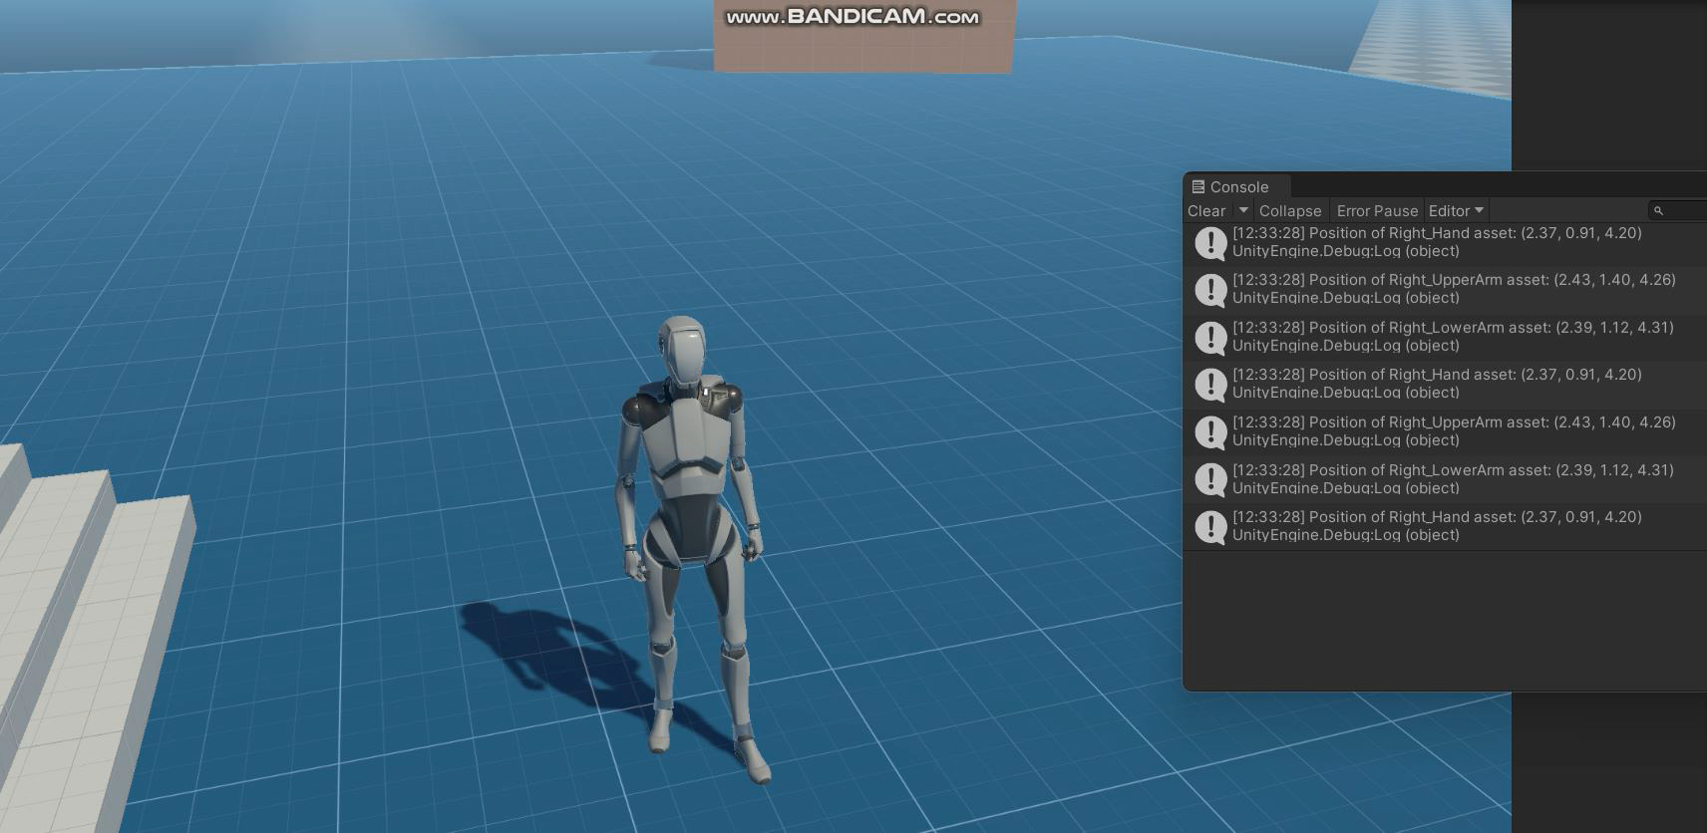

Slide 12
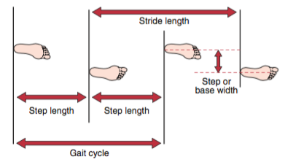
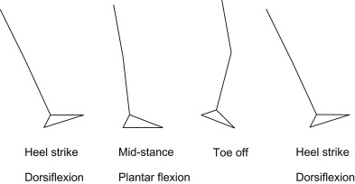
Future work
Using the obtained coordinates and angles we will render a 3D animation on Unity. The simulation can be used to track the position, orientation, and motion of each bone and joint, which can then be used to calculate various gait parameters such as step length, stride length, cadence, and foot angle.
Image Source :Peripheral Nerve Stimulation, Dr.Dennis Fitzpatrick PhD CEng BEng(Hons)

Slide 13
References
Unity :https://docs.unity3d.com/Manual/index.html
Open CV: Ivan Culjak, David Abram, Tomislav Pribanic, Hrvoje Dzapo, Mario Cifrek Faculty of electrical engineering and computing, University of Zagreb, Zagreb, Croatia (2012) A brief introduction to OpenCV
Pose mediapipe Library: Amrutha K; Prabu P; Joy Paulose (2021) , Human Body Pose Estimation and Applications.

Slide 14
Thankyou!!!

